Slide 1
투빅스 11기 정규과정
ToBig’s 10기 박성진
Convolutional Neural Networks

Slide 2
Unit 01 ㅣ Intro
Unit 02 ㅣ Layers in CNN
Contents
Unit 03 ㅣ Convolution
Unit 04 ㅣ Sub-Sampling
Unit 05 ㅣ Summary

Slide 3
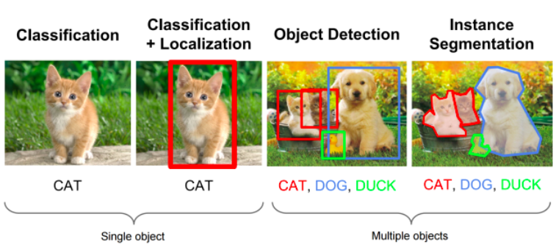
Intro - Applications of CNN

Slide 4
Intro - Applications of CNN
Classification
Detection
Segmentation

Slide 5
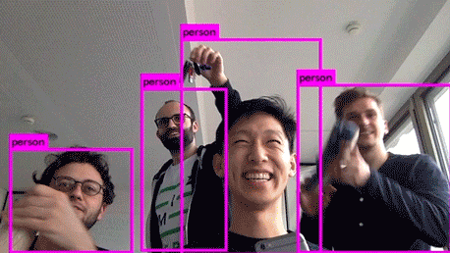
Intro - Applications of CNN

Slide 6
Intro - Applications of CNN
Real Time Object Detection

Slide 7
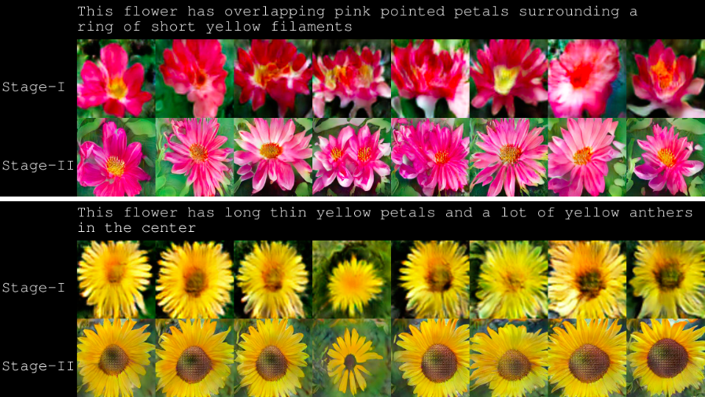
Intro - Applications of CNN

Slide 8
Intro - Applications of CNN
Image Caption Generation

Slide 9
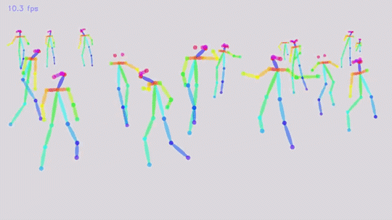
Intro - Applications of CNN

Slide 10
Intro - Applications of CNN
Real Time Pose Estimation

Slide 11
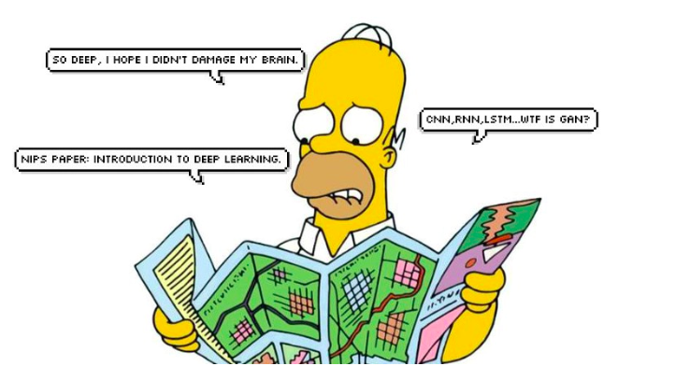
Intro - Applications of CNN

Slide 12
Intro - Applications of CNN
Don’t shut down your brain

Slide 13
Unit 01 ㅣ Intro
Unit 02 ㅣ Layers in CNN
Contents
Unit 03 ㅣ Convolution
Unit 04 ㅣ Sub-Sampling
Unit 05 ㅣ Summary

Slide 14
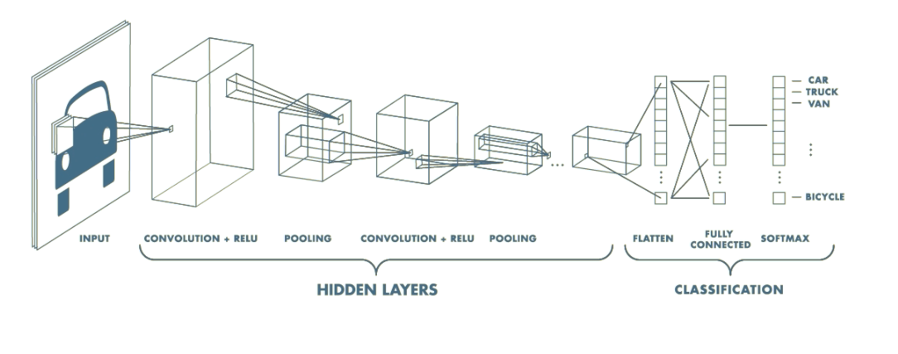
Layers in CNN
This is Pretty much everything about the convolutional neural network
Convolution + Subsampling + Full Connection

Slide 15
Layers in CNN
So how does it work?
This is Pretty much everything about the convolutional neural network
Convolution + Subsampling + Full Connection

Slide 16
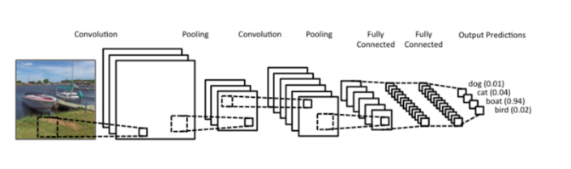
Layers in CNN
CNN = Convolutions followed by subsampling and fully connected layer
Feature Extraction <- Convolution + subsampling layers
Classifier <- Fully connected layer

Slide 17
Layers in CNN
Why is so powerful?
Local connectivity(receptive field)
Shared Weights and Biases
Compositionality

Slide 18
Typical Neural Network
INPUT
HIDDEN
OUTPUT

Slide 19
Typical Neural Network
INPUT
HIDDEN
OUTPUT

Slide 20
Typical Neural Network
INPUT
HIDDEN
OUTPUT

Slide 21
Typical Neural Network
INPUT
HIDDEN
OUTPUT

Slide 22
Convolutional Neural Network
INPUT
HIDDEN
OUTPUT

Slide 23
Convolutional Neural Network
Conv & Activation
Pooling
INPUT
HIDDEN
OUTPUT

Slide 24
Convolutional Neural Network
Flatten & FC
INPUT
HIDDEN
OUTPUT

Slide 25
Convolutional Neural Network
Conv & Activation
INPUT
HIDDEN
OUTPUT

Slide 26
Convolutional Neural Network
Conv & Activation
INPUT
HIDDEN
OUTPUT

Slide 27
Convolutional Neural Network
Conv & Activation
INPUT
HIDDEN
OUTPUT

Slide 28
Convolutional Neural Network
Conv & Activation
INPUT
HIDDEN
OUTPUT

Slide 29
Convolutional Neural Network
Conv & Activation
INPUT
HIDDEN
OUTPUT

Slide 30
Convolutional Neural Network
Conv & Activation
INPUT
HIDDEN
OUTPUT

Slide 31
Convolutional Neural Network
Conv & Activation
INPUT
HIDDEN
OUTPUT

Slide 32
Convolutional Neural Network
Pooling
INPUT
HIDDEN
OUTPUT

Slide 33
Convolutional Neural Network
Pooling
INPUT
HIDDEN
OUTPUT

Slide 34
Convolutional Neural Network
Pooling
INPUT
HIDDEN
OUTPUT

Slide 35
Convolutional Neural Network
Pooling
INPUT
HIDDEN
OUTPUT

Slide 36
Convolutional Neural Network
Pooling
INPUT
HIDDEN
OUTPUT

Slide 37
Convolutional Neural Network
Flatten
INPUT
HIDDEN
OUTPUT

Slide 38
Convolutional Neural Network
Flatten
INPUT
HIDDEN
OUTPUT

Slide 39
Convolutional Neural Network
Flatten
INPUT
HIDDEN
OUTPUT

Slide 40
Convolutional Neural Network
Flatten
INPUT
HIDDEN
OUTPUT

Slide 41
Convolutional Neural Network
Flatten
INPUT
HIDDEN
OUTPUT

Slide 42
Convolutional Neural Network
FC
INPUT
HIDDEN
OUTPUT

Slide 43
Convolutional Neural Network
FC
INPUT
HIDDEN
OUTPUT

Slide 44
Convolutional Neural Network
FC
INPUT
HIDDEN
OUTPUT

Slide 45
Convolutional Neural Network
FC
INPUT
HIDDEN
OUTPUT

Slide 46
Convolutional Neural Network
Flatten & FC
INPUT
HIDDEN
OUTPUT

Slide 47
Unit 01 ㅣ Intro
Unit 02 ㅣ Layers in CNN
Contents
Unit 03 ㅣ Convolution
Unit 04 ㅣ Sub-Sampling
Unit 05 ㅣ Summary

Slide 48
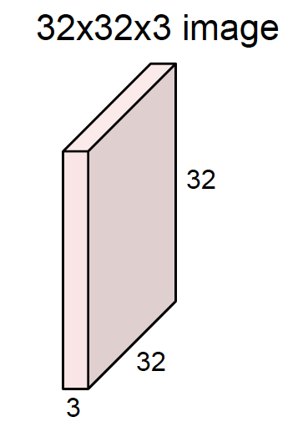
Convolution

Slide 49
Convolution
height
width
depth

Slide 50
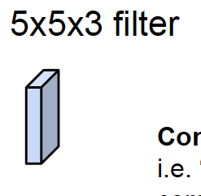
Convolution
height
Convolve the filter with the image “Slide over the image spatially, computing dot products”
width
depth

Slide 51
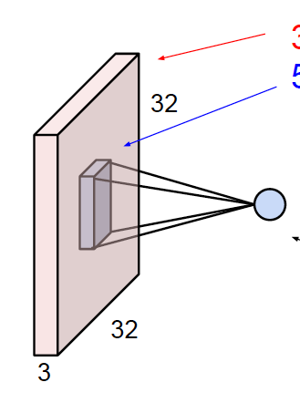
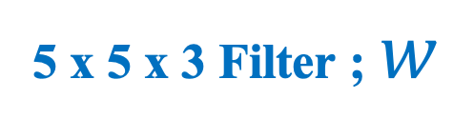
Convolution
32 x 32 x 3 image
5 x 5 x 3 Filter ; $w$
1 number
the result of taking a dot product
between the filter and a local receptive field
ex) 5*5*3 = 75-dimensional dot product + bias

Slide 52
Convolution
2
3
0
1
3
2
1
0
2
2
2
2
1
0
1
2
1
1
1
0
0
1
0
1
3
2
2
0
0
2
3
0
1
0
2
0
0
0
0
2
0
1
0
1
0
0
0
2
2
2
2
1
3
2
3
2
1
0
Input Volumn ( 7x7 )
Filter ( 3 x 3)
Convolved Feature Volumn ( 5 x 5)

Slide 53
Convolution
2
3
0
1
3
2
1
Dot Product
6
0
2
2
2
2
1
0
1
2
1
1
1
0
0
1
0
1
3
2
2
0
0
2
3
0
1
0
2
0
0
0
0
2
0
1
0
1
0
0
0
2
2
2
2
1
3
2
3
2
1
0
Input Volumn
Filter ( 3 x 3)
Convolved Feature Volumn ( 5 x 5)

Slide 54
Convolution
2
3
0
1
3
2
1
Dot Product
6
9
0
2
2
2
2
1
0
1
2
1
1
1
0
0
1
0
1
3
2
2
0
0
2
3
0
1
0
2
0
0
0
0
2
0
1
0
1
0
0
0
2
2
2
2
1
3
2
3
2
1
0
Input Volumn
Filter ( 3 x 3)
Convolved Feature Volumn ( 5 x 5)

Slide 55
Convolution
2
3
0
1
3
2
1
Dot Product
6
9
7
0
2
2
2
2
1
0
1
2
1
1
1
0
0
1
0
1
3
2
2
0
0
2
3
0
1
0
2
0
0
0
0
2
0
1
0
1
0
0
0
2
2
2
2
1
3
2
3
2
1
0
Input Volumn
Filter ( 3 x 3)
Convolved Feature Volumn ( 5 x 5)

Slide 56
Convolution
2
3
0
1
3
2
1
Dot Product
6
9
7
6
6
0
2
2
2
2
1
0
9
7
7
6
5
1
2
1
1
1
0
0
1
0
1
6
5
2
3
3
3
2
2
0
0
2
3
0
1
0
5
4
4
6
9
2
0
0
0
0
2
0
1
0
1
5
6
6
8
4
0
0
0
2
2
2
2
1
3
2
3
2
1
0
Input Volumn
Filter ( 3 x 3)
Convolved Feature Volumn ( 5 x 5)

Slide 57
Convolution
0
2
0
0
0
0
1
Dot Product
0
2
0
0
0
1
2
2
2
2
1
0
1
2
2
2
2
0
2
1
1
1
0
0
1
0
0
0
2
1
1
1
3
2
2
0
0
2
2
0
0
0
3
2
2
0
0
2
0
3
0
0
2
0
0
0
0
2
0
3
0
0
1
0
0
2
2
2
2
0
1
0
1
0
0
0
Input Volumn
Filter ( 3 x 3)
Convolved Feature Volumn ( 5 x 5)

Slide 58
Convolution
1
0
2
0
1
0
3
Dot Product
2
2
2
2
1
0
2
2
2
2
1
0
2
1
1
1
0
2
2
1
1
1
0
3
0
0
0
2
2
0
0
2
0
2
2
0
0
2
0
0
1
0
0
0
0
0
2
0
0
0
0
0
2
2
0
0
0
0
0
2
2
2
2
0
0
2
2
2
0
0
0
2
0
2
0
0
Input Volumn
Filter ( 3 x 3)
Convolved Feature Volumn ( 5 x 5)

Slide 59
Convolution
6
9
7
6
6
0
2
0
0
0
2
2
2
2
1
9
7
7
6
5
1
2
2
2
2
2
1
1
1
0
6
5
2
3
3
0
2
1
1
1
2
2
0
0
2
5
4
4
6
9
3
2
2
0
0
0
0
0
0
2
5
6
6
8
4
2
0
3
0
0
0
0
2
2
2
8
13
9
8
7
12
10
10
9
7
8
9
3
4
6
8
6
6
6
11
7
6
11
10
6

Slide 60
Convolution
6
9
7
6
6
0
2
0
0
0
2
2
2
2
1
9
7
7
6
5
1
2
2
2
2
2
1
1
1
0
6
5
2
3
3
0
2
1
1
1
2
2
0
0
2
5
4
4
6
9
3
2
2
0
0
0
0
0
0
2
5
6
6
8
4
2
0
3
0
0
0
0
2
2
2
8
13
9
8
7
3x3x3 filter
12
10
10
9
7
27-dimensional dot product
8
9
3
4
6
8
6
6
6
11
7
6
11
10
6

Slide 61
Convolution
6
9
7
6
6
0
2
0
0
0
2
2
2
2
1
9
7
7
6
5
1
2
2
2
2
2
1
1
1
0
6
5
2
3
3
0
2
1
1
1
2
2
0
0
2
5
4
4
6
9
3
2
2
0
0
0
0
0
0
2
5
6
6
8
4
2
0
3
0
0
0
0
2
2
2
8
13
9
8
7
3x3x3 filter
12
10
10
9
7
27-dimensional dot product
8
9
3
4
6
8
6
6
6
11
7
6
11
10
6

Slide 62
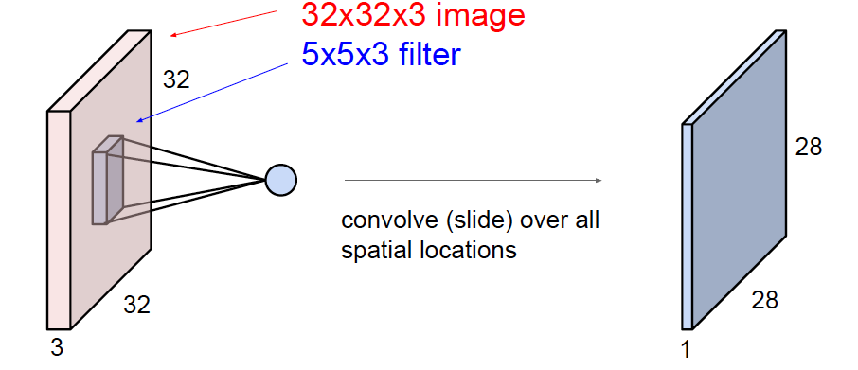
Convolution

Slide 63
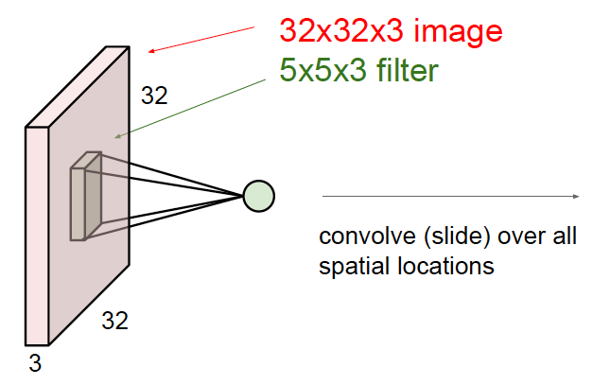
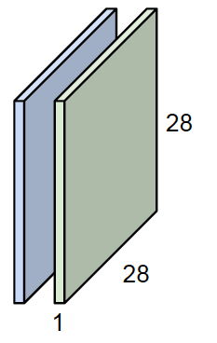
Convolution

Slide 64
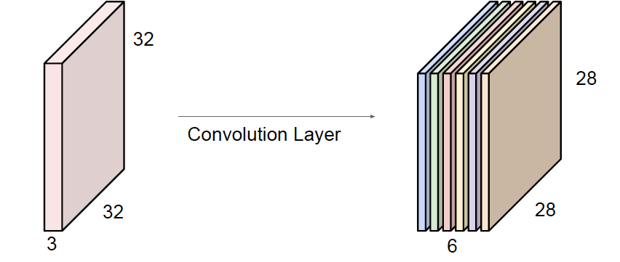
Convolution
예를들어, 6개의 5x5x3 filter가 있다면, 6개의 feature map이 생성됨
6개의 feature map을 stack up 하여 28x28x6 의 새로운 size의 이미지를 얻음

Slide 65
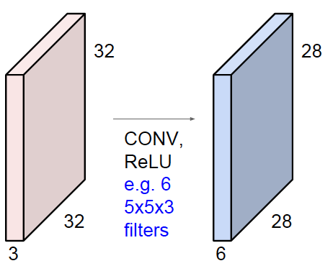
Convolution

Slide 66
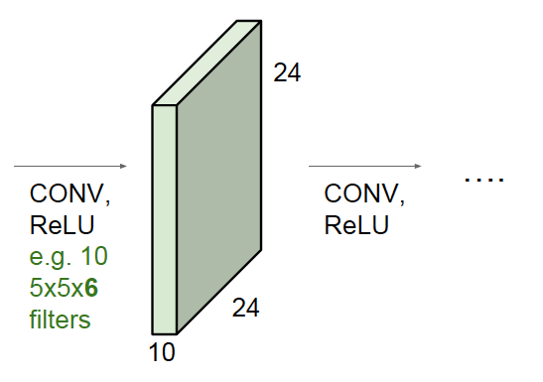
Convolution

Slide 67
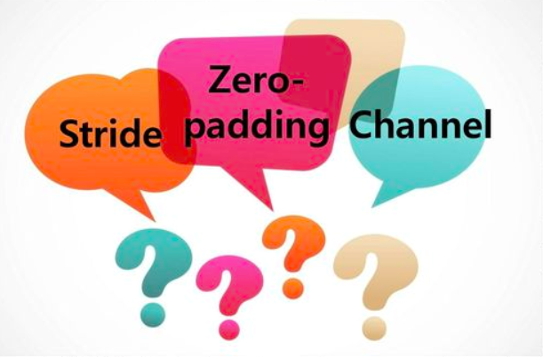
Get familiar with this

Slide 68
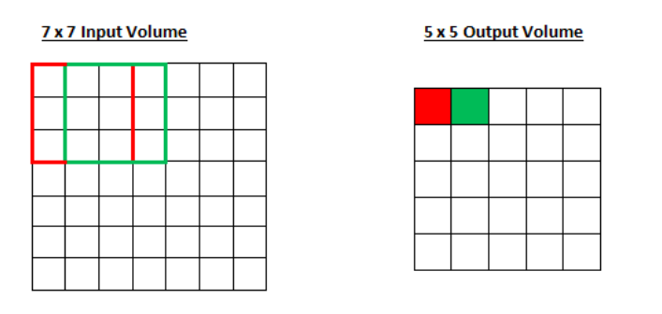
Stride
Stride =The amount by which the filter shifts
Stride is normally set in a way so that the output volume is an integer and not a fraction
Stride = 1

Slide 69
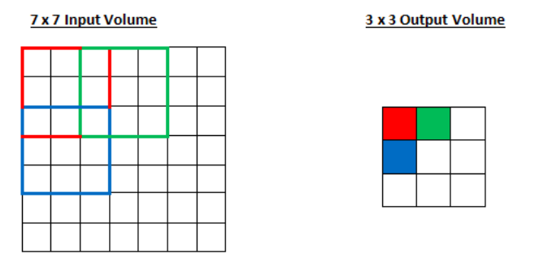
Stride
Stride =The amount by which the filter shifts
Stride is normally set in a way so that the output volume is an integer and not a fraction
Stride = 2

Slide 70
Stride
Stride =The amount by which the filter shifts
Stride is normally set in a way so that the output volume is an integer and not a fraction
?
Stride = 3

Slide 71
Stride
Stride =The amount by which the filter shifts
Stride is normally set in a way so that the output volume is an integer and not a fraction
doesn’t fit!
cannot apply 3x3 filter on
7x7 input with stride 3.
Stride = 3

Slide 72
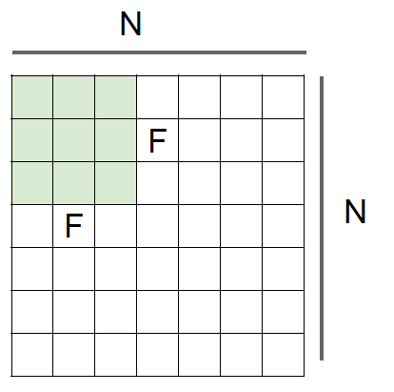
Stride
N = Input size
F = Filter size
Output size: {(N - F) / stride} + 1
Ex) N=7, F=3 stride=1 -> {(7-3)/1} + 1 = 5 Stride=2 -> {(7-3)/2} + 1 = 3 Stride=3 -> {(7-3)/3} + 1 = 2.33 X

Slide 73
Padding
32x32 input convolved repeatedly with 5x5 filters shrinks volumes spatially! (32 -> 28 -> 24 ...). Shrinking too fast is not good, doesn’t work well.

Slide 74
Padding
0
0
0
0
0
0
0
0
0
Ex) Input 7x7 Filter 3x3, stride = 1 zero pad with 1 pixel border what’s the output?
0
0
0
0
0
0
0
0
0
0
0
0
Recall Output size: {(N - F) / stride} + 1
0
0
0
0
0
0
0
0
0
0
0

Slide 75
Padding
0
0
0
0
0
0
0
0
0
Ex) Input 7x7 Filter 3x3 pad with 1 pixel border -> what’s the output?
0
0
0
0
0
0
0
0
0
0
0
0
7x7 output!!
output = {(9-3)/1} + 1
0
0
0
0
0
0
0
0
0
0
0

Slide 76
Padding
0
0
0
0
0
0
0
0
0
Ex) Input 7x7 Filter 3x3 pad with 1 pixel border -> what’s the output?
0
0
0
0
0
0
0
0
0
0
0
0
7x7 output!!
일반적으로 stride =1 을 주며, Filter size 가 3인 경우 zero-padding = 1 을 주면
0
0
0
0
0
0
0
0
0
0
0
공식에 따라, input size 를 보존하는 output이 생성

Slide 77
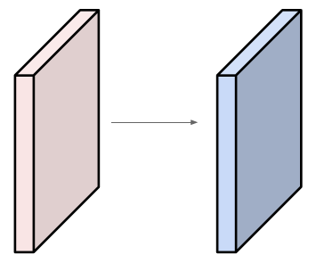
Example
Input volume: 32x32x3 10 5x5 filters with stride 1, pad 2
Number of parameters in this layer?

Slide 78
Example
Input volume: 32x32x3 10 5x5 filters with stride 1, pad 2
Number of parameters in this layer?
Each filter has 5*5*3 + 1 = 76 params ( +1 for bias) -> 76 * 10 = 760

Slide 79
Unit 01 ㅣ Intro
Unit 02 ㅣ Layers in CNN
Contents
Unit 03 ㅣ Convolution
Unit 04 ㅣ Sub-Sampling
Unit 05 ㅣ Summary

Slide 80
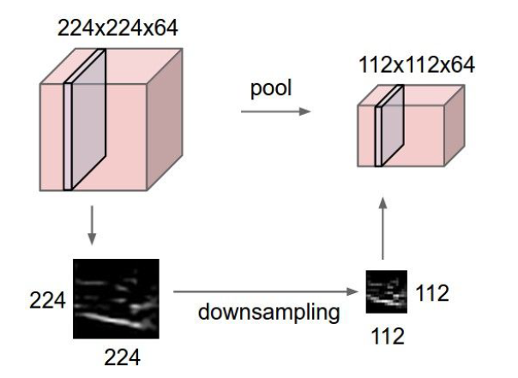
Subsampling
makes the representations smaller and more manageable
operates over each activation map independently:

Slide 81
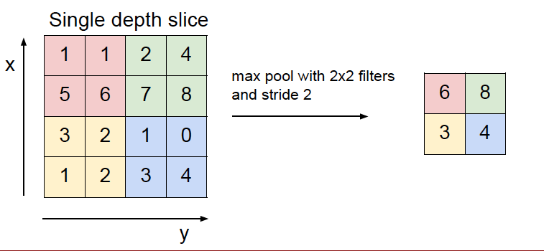
Max-pooling

Slide 82
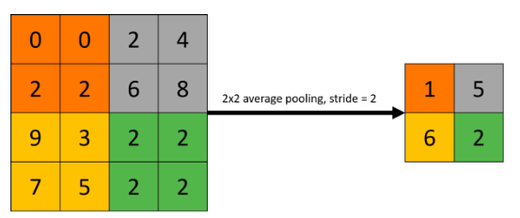
Average Pooling
Single depth slice
Average pool with 2x2 filters and stride 2

Slide 83
Unit 01 ㅣ Intro
Unit 02 ㅣ Layers in CNN
Contents
Unit 03 ㅣ Convolution
Unit 04 ㅣ Sub-Sampling
Unit 05 ㅣ Summary

Slide 84
Layers in CNN
CNN = Convolutions followed by subsampling and fully connected layer
Feature Extraction <- Convolution + subsampling layers
Classifier <- Fully connected layer

Slide 85
Layers in CNN
This is Pretty much everything about the convolutional neural network
Convolution + Subsampling + Full Connection

Slide 86
Layers in CNN
Why is so powerful?
Local connectivity(receptive field)
Shared Weights and Biases
Compositionality

Slide 87
Q & A

Slide 88
Reference
https://cs.stanford.edu/people/karpathy/convnetjs/demo/cifar10.html
http://cs231n.github.io/convolutional-networks/
https://medium.com/fbdevclagos/applications-of-deep-learning-4f725f9147ac
imagenet-classification-with-deep-convolutional-neural-networks(Alex Krizhevsky 2012)
https://laonple.blog.me/220643128255

